Slide 1

Welcome!

Slide 2

“Capital One Launches First True Open Banking Platform in U.S.”
- ProgrammableWeb, March 11, 2016

Slide 3
We believe the future of digital experiences will be co-created.
External developers, startups, and other innovators
will be co-creators of the next generation of
digital banking and fintech experiences.

Slide 4
was built around the concept of “exchange” in every sense — the exchange of ideas, information, and open source code. Our ground-breaking platform business puts powerful new capabilities into the hands of external developers and partners while providing best-in-class experiences for our:
API Products created, supported and evolved through our partnerships to provide great digital experiences to consumers
Open Source Projects built and maintained by an active community of developers from within Capital One and beyond
Professional Services designed to guide partners and collaborators through every stage of the integration process

Slide 5
Digital Identity Products (Invite Only)
We’re making our Identity Verification APIs available to selected business partners as part of this new, limited beta program.
Online identity fraud continues to grow across every channel and touchpoint of the end-to-end customer engagement cycle. At Capital One, we understand that access to trusted identity information is not only critical to managing our business across the customer lifecycle – it's critical to digital commerce and the economy at large.
That’s why we're excited to partner with selected businesses to test a new line of Digital Identity Products that balance a simple, elegant user experience with advanced identity capabilities.

Slide 6
Vault Secure Storage (Invite Only)
Vault facilitates engagement between a consumer and a business by enabling identity verified storage, organization and handling of important digital data
Today, both consumers and businesses struggle with the high friction that comes with managing their digital lives. Consumers experience significant friction organizing documents and managing relationships with companies. For businesses, sharing private documents via mainstream consumer tech solutions poses trust and customer engagement issues.
Vault Secure Storage will benefit both consumers and businesses by allowing secured, verified asset delivery and retrieval.

Slide 7

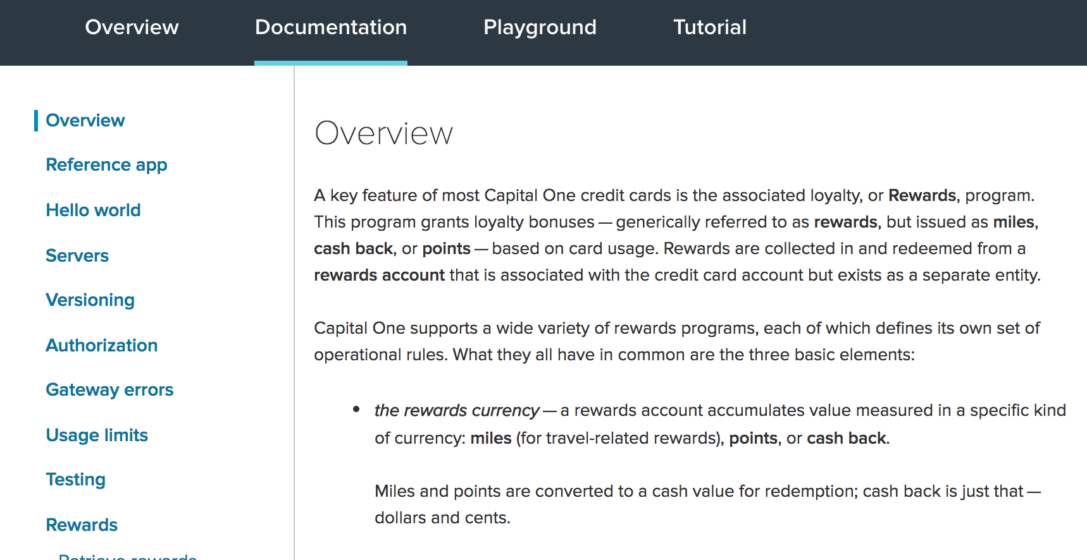
Comprehensive Documentation
Thoughtful, thorough documentation is a vital component of our APIs.
Our team of writers works closely with our product and tech teams to provide clear and
concise guides specifically for our primary audience – developers.

Slide 8


Join the Conversation
Follow us on twitter @CapitalOneDevEx
You can also find us on:
Medium.com/capital-one-developers
Developer.CapitalOne.com/blogs/
Capital One DevExchange on Spotify

